Slide 1





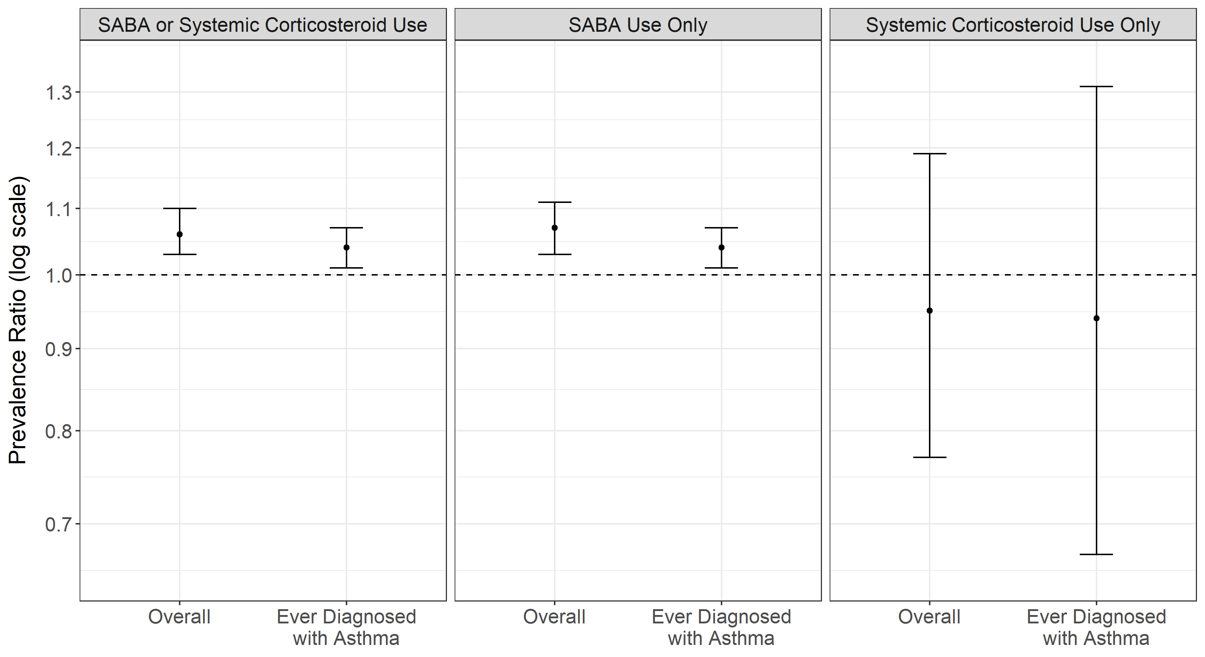
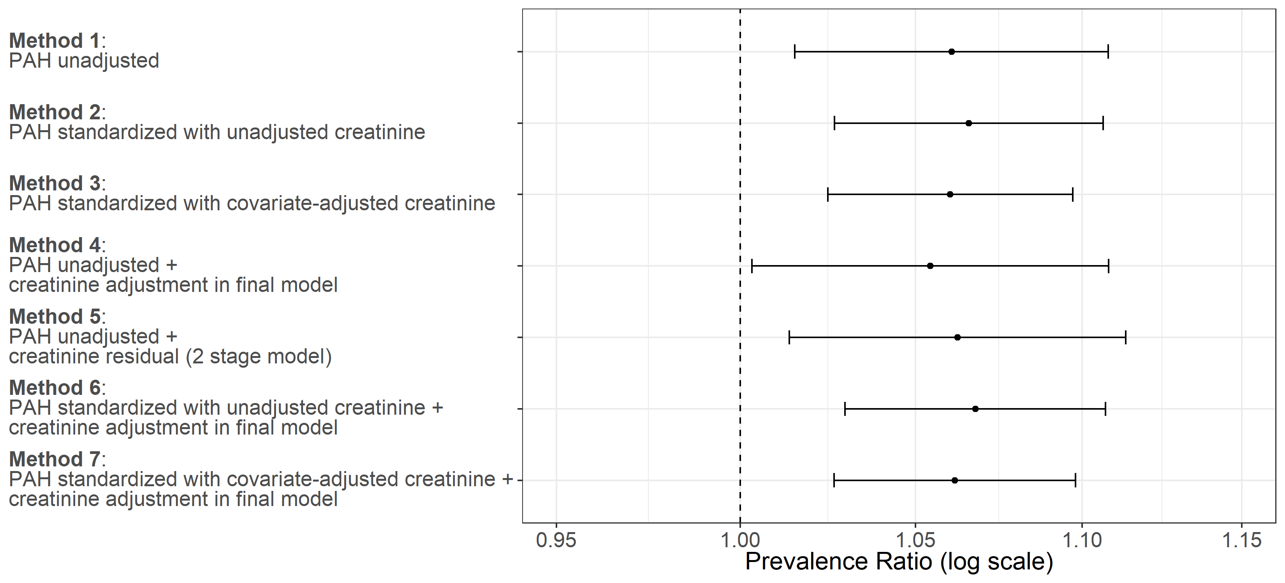
PAH exposure was positively associated with SABA or systemic corticosteroid use, across urine creatinine dilution adjustment methods
Non-Cognitive Predictors of Student Success: A Predictive Validity Comparison Between Domestic and International Students
Biomarkers of Air Pollution and Asthma Medication Use: Addressing Temporal Limitations of Environmental Health Analyses Within NHANES
PRESENTER:
Stephen P. Uong, MPH
BACKGROUND: Within cross-sectional studies like the U.S. National Health and Nutritional Examination Survey (NHANES), previous studies have used ever having an asthma diagnosis as an outcome when examining associations with polycyclic aromatic hydrocarbon (PAH) exposure.
OBJECTIVE: Examine the relationship between markers of PAH exposure and 30-day short-acting beta agonist (SABA) or systemic corticosteroid use, a temporally appropriate indicator for recent asthma symptoms.
METHODS
Study Population: N=16,550 participants across multiple waves of NHANES (2005-2016) with laboratory data.
Statistical analysis using quasi-Poisson regression
Independent variable: PAH metabolite, urinary 1-hydroxypyrene
Dependent variable: SABA or systemic corticosteroid use
Confounders: Age, female/male designation, race/ethnicity, poverty, insurance coverage, and serum cotinine
Effect Modifiers: Age, controller medication use
Sensitivity Analyses:
Among those ever diagnosed with asthma
Different urine creatinine dilution adjustment methods
RESULTS
After controlling for confounding, an increase of one standard deviation of PAH exposure was associated with 1.06 (95% CI 1.03-1.10) times the prevalence of SABA or systemic corticosteroid use.
No effect modification by age or controller medication use.
Sensitivity Analyses:
Among those ever diagnosed with asthma, similar prevalence ratio
Different urine creatinine dilution adjustment methods, similar prevalence ratio across methods
CONCLUSIONS
PAH exposure was positively associated with SABA or systemic corticosteroid use, across various urine dilution adjustment methods. It is important to ensure appropriate temporality between exposures and outcomes in cross-sectional studies.
Stephen Uong, MPH¹, Stephanie Lovinsky-Desir, MD, MS², Jeanette Stingone, PhD, MPH¹
¹Columbia University, Department of Epidemiology
²Columbia University, Vagelos College of Physicians and Surgeons
This study was supported by the National Institutes of Health, National Institute of Environmental Health Grant T32 ES007322 (PI: G. Miller) and R00 ES027022(PI: J. Stingone).
Notes:
Notes:
In Powerpoint, click View > Guides
Keep text within gutter guides.
Author list: Don’t split names onto two lines (e.g., “Jimmy [break] Smith”). If that happens, use a new line, unless you need the space. Bold the first names of anybody who’s presenting in person.
Intro/methods/result: Do not drop below font size 28, but if you have extra space, jack up the font size until the space is full.
Do not use color in the sidebars except in graphs/figures. It’ll pull attention from the center and slow interpretation for passersby.

